Slide 1

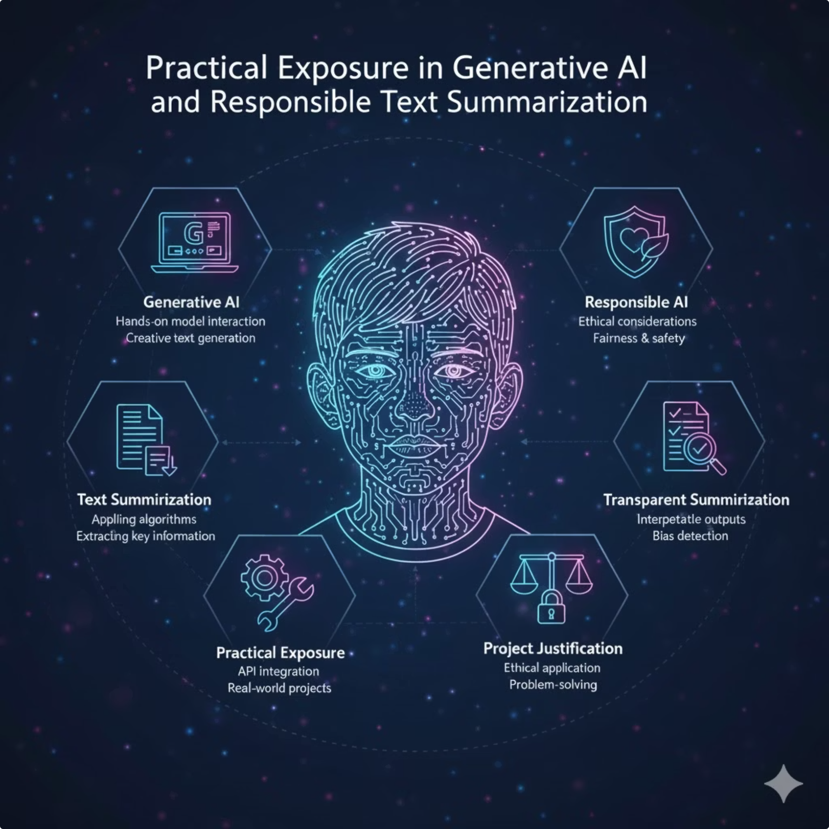
Practical Exposure in Generative AI and Responsible Text Summarization
An Industrial Internship Report Submitted in Partial Fulfillment of the Requirements for the degree of BACHELOR’S Of TECHNOLOGY in Information Technology

Slide 2

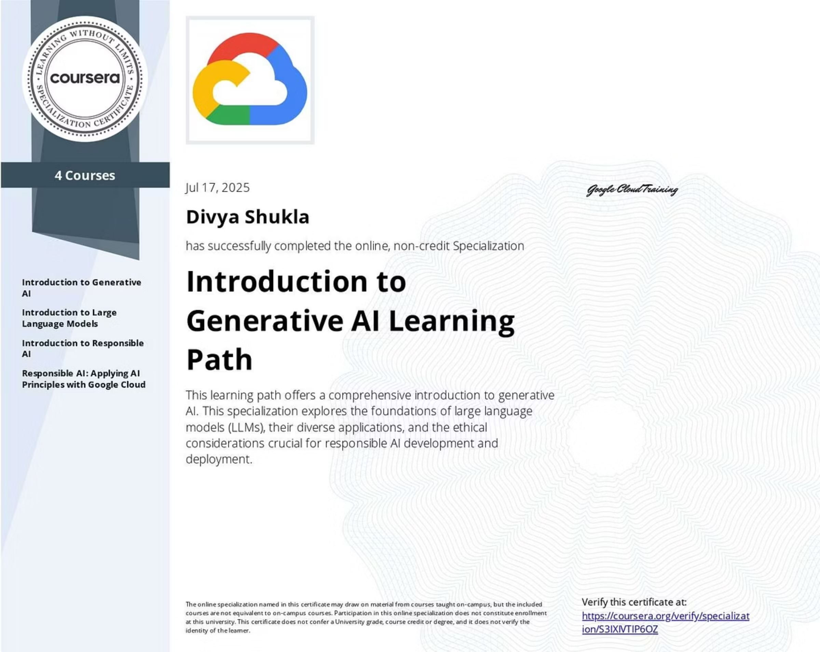
Internship Report
Submitted by Divya Shukla Under the Supervision of Mr. Abhishek Yadav (Coordinator IT)
Goel Institute of Technology & Management Lucknow affiliated to Dr. APJ Abdul Kalam Technical University, Lucknow

Slide 3
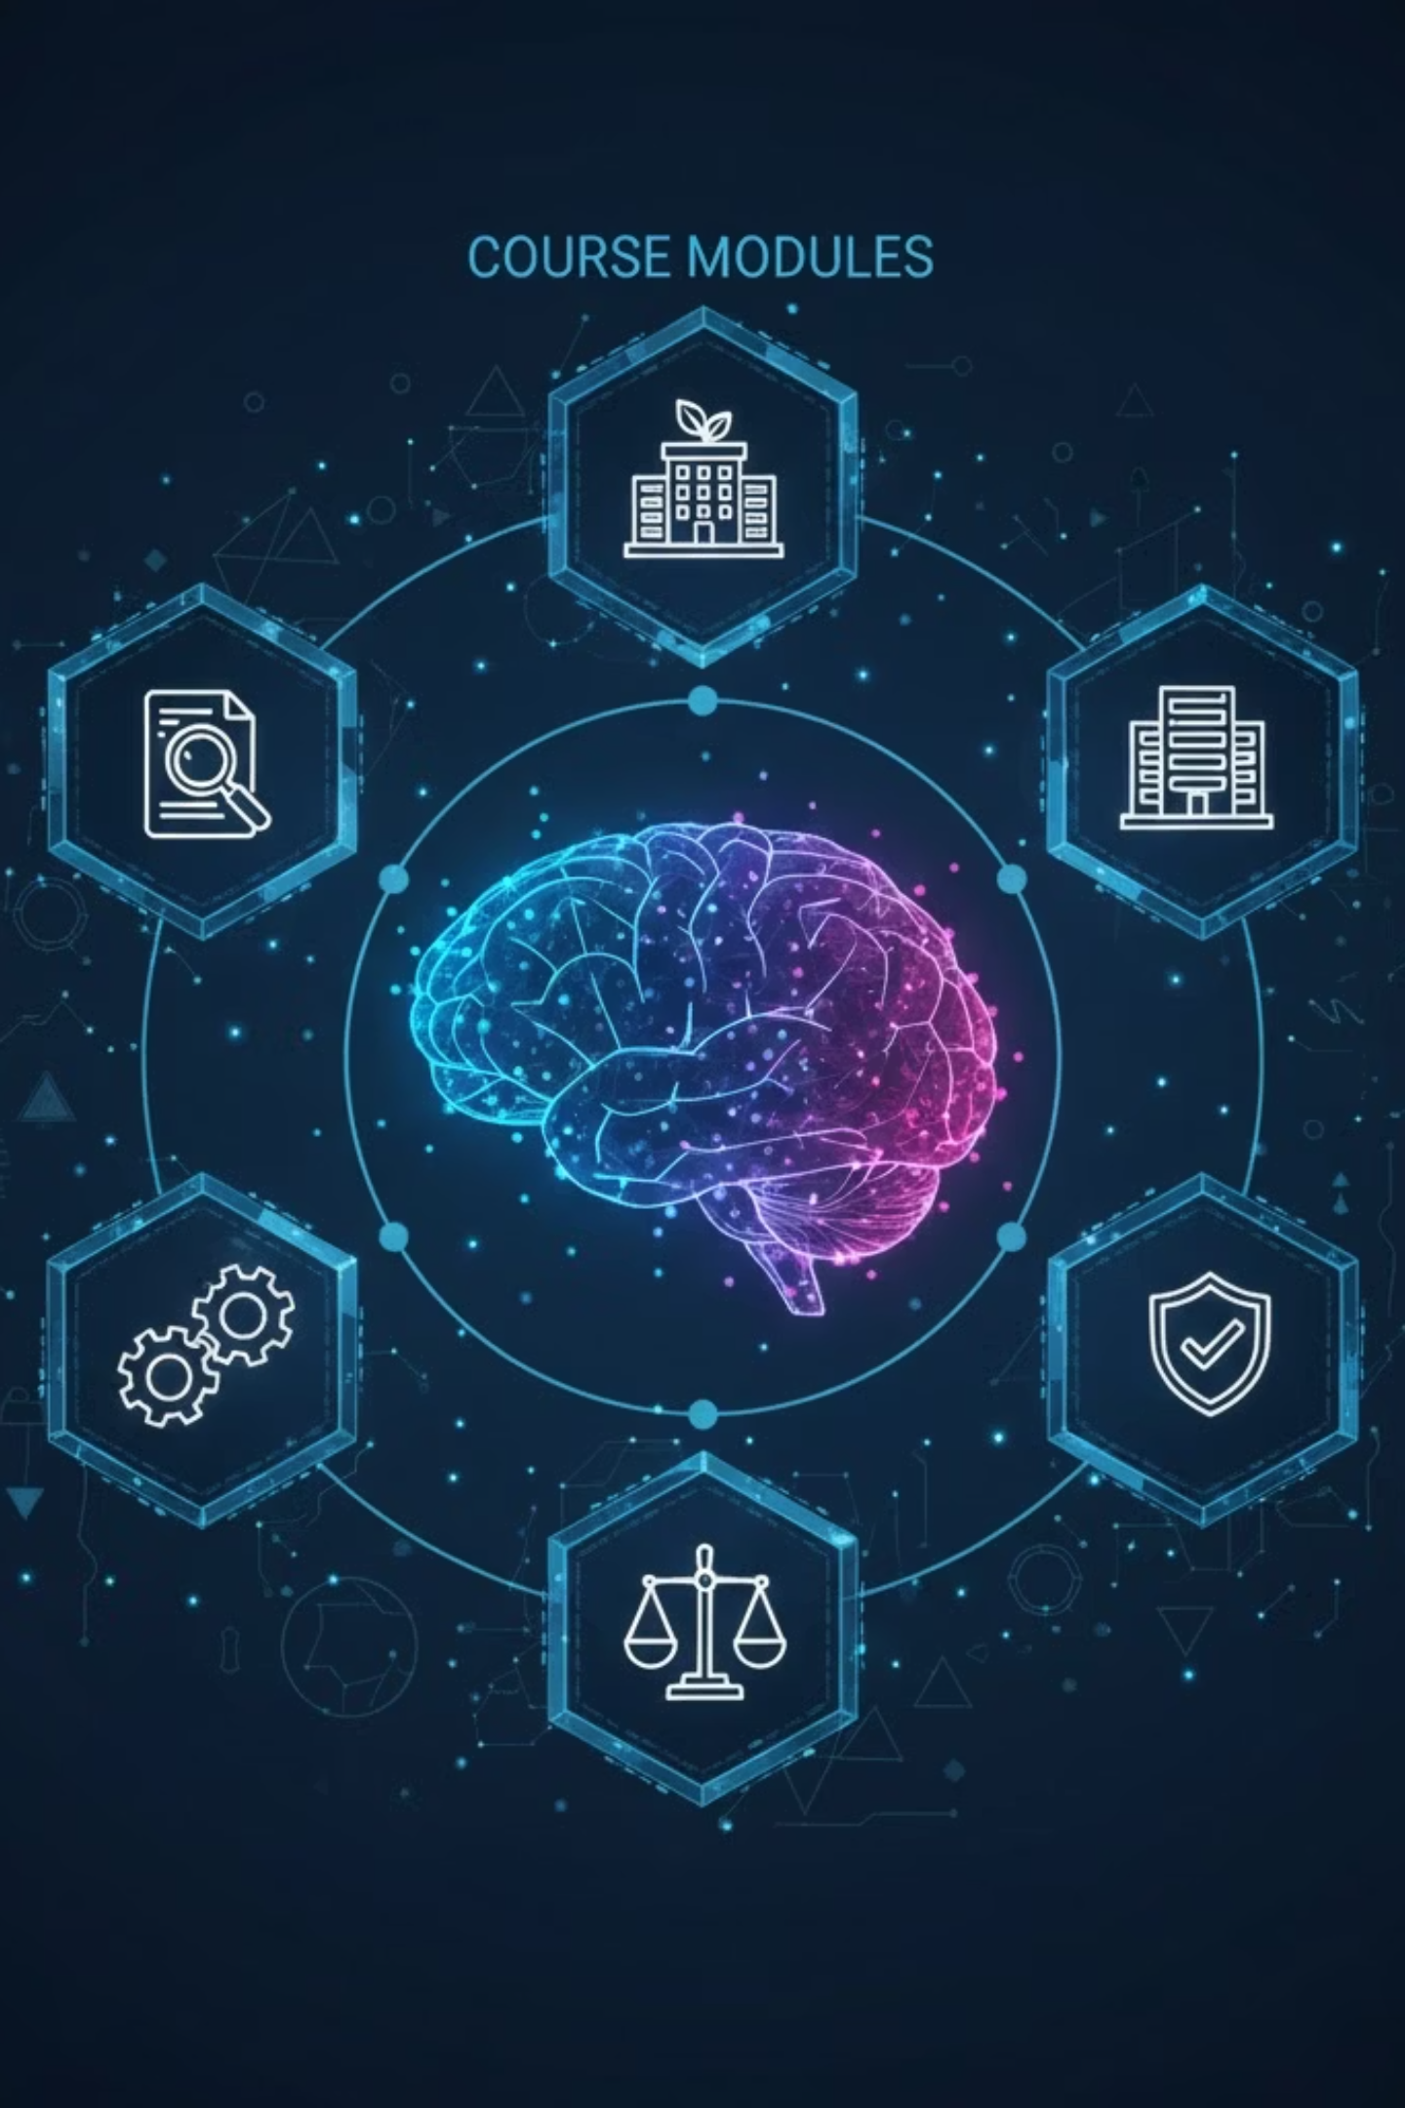
Course Modules Completed
Introduction to Generative AI
Introduction to Large Language Models
Introduction to Responsible AI
Responsible AI: Applying Principles with Google Cloud

Slide 4
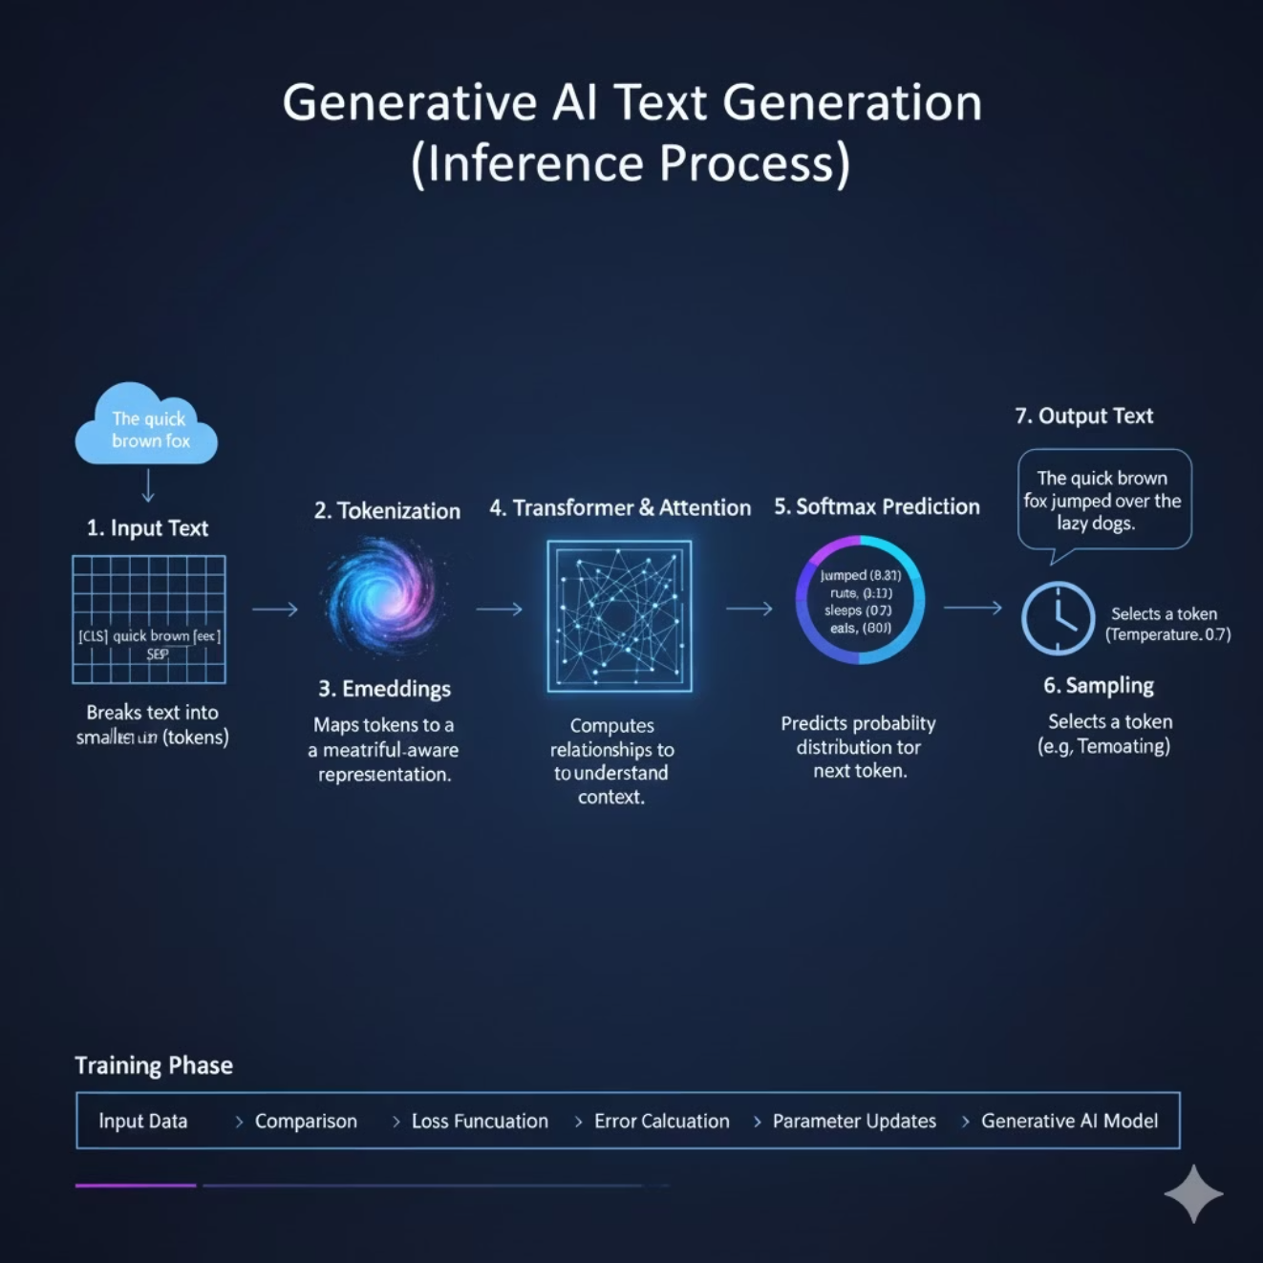
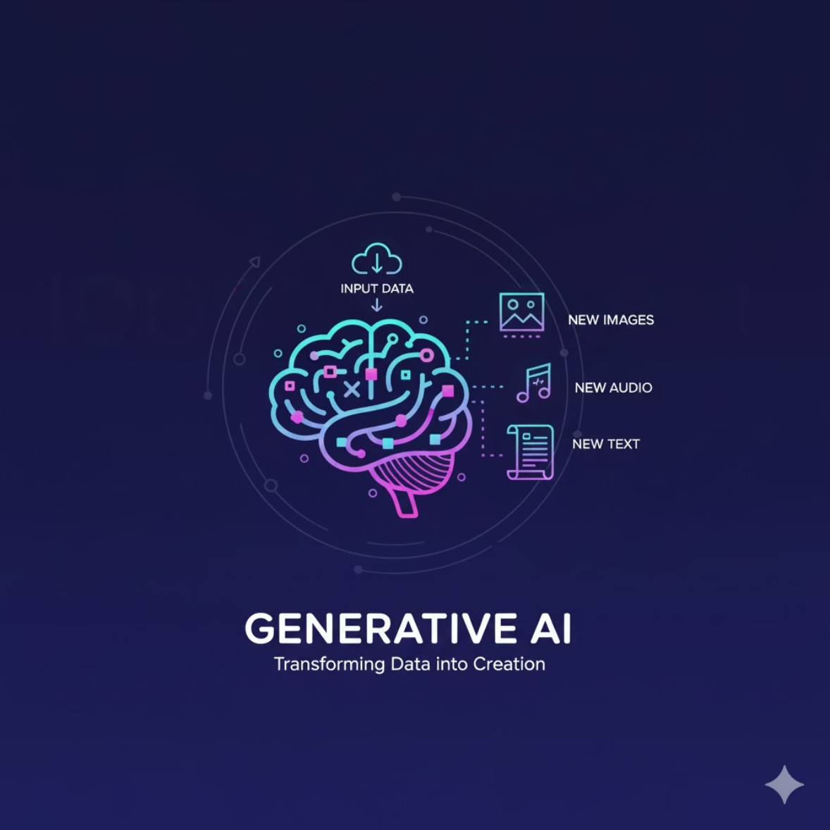
Module 1: Introduction to Generative AI
What is Generative AI?
How it Works
Models capable of generating new text, images, or audio, rather than just classifying inputs.

Slide 5

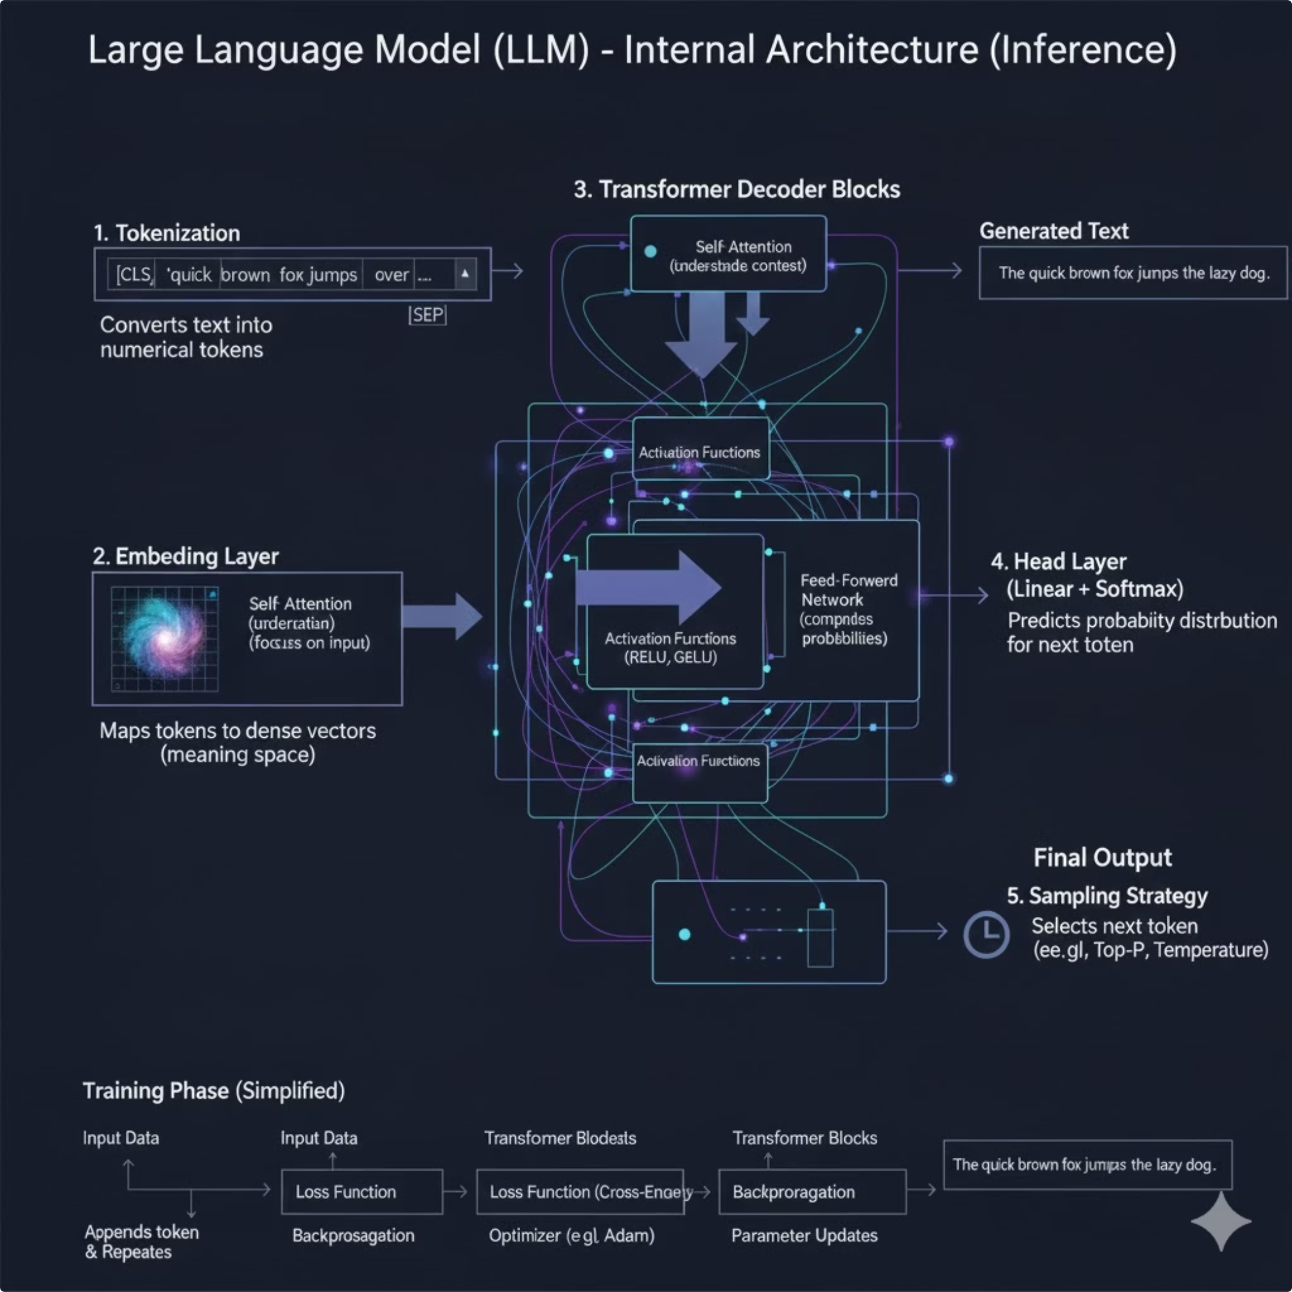
Module 2: Introduction to LLMs
Large Language Models (LLMs) are advanced AI systems trained on massive datasets to understand, generate, and manipulate human language with high precision. They use complex neural networks called Transformers to analyze context and predict the most logical next word in a sequence.

Slide 6
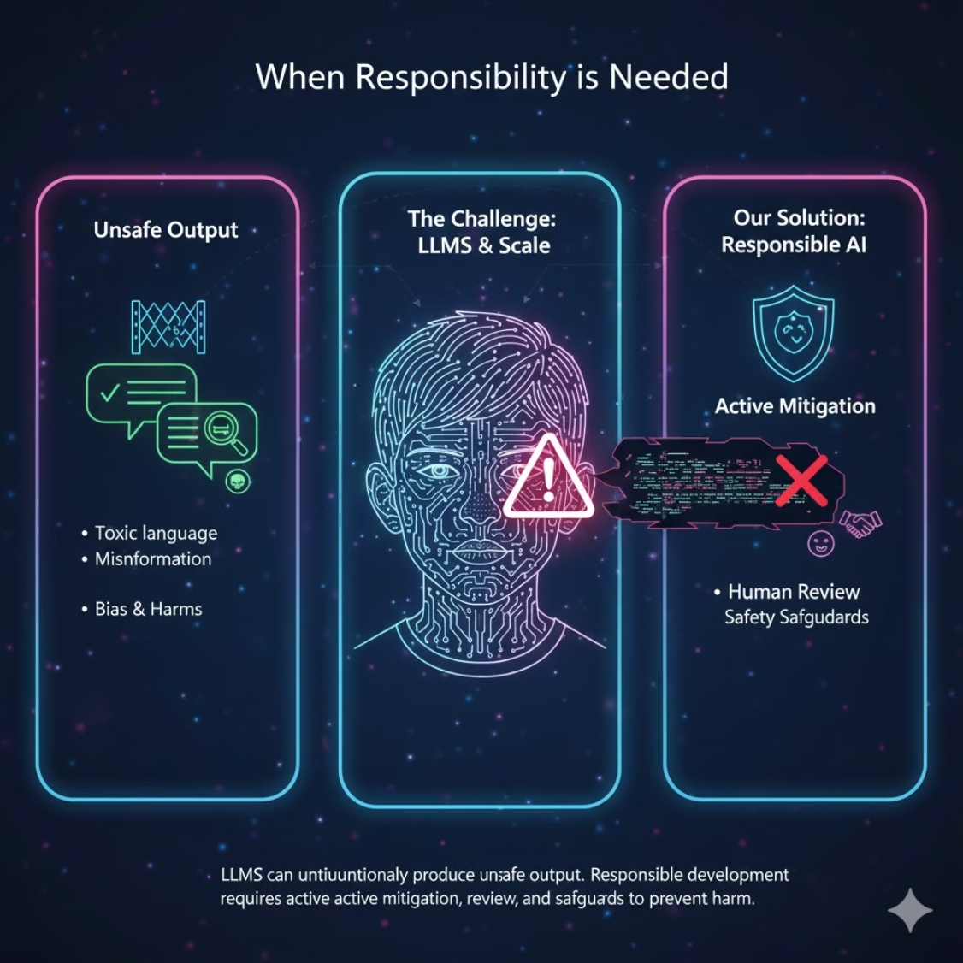
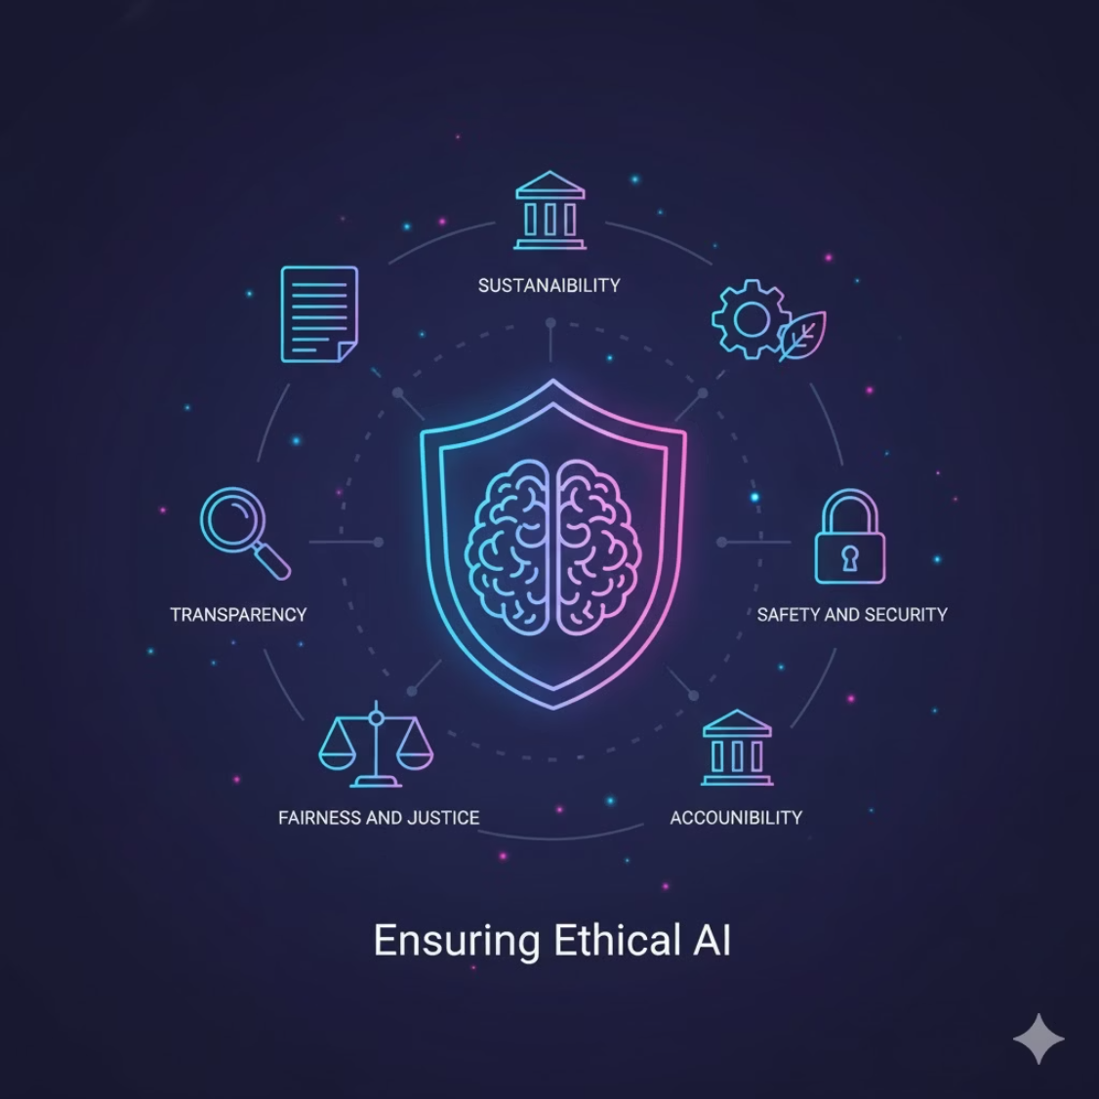
Module 3: Introduction to Responsible AI
Ensuring Ethical AI
When Responsibility is Needed
Responsible AI ensures systems operate safely, fairly, and ethically.
LLMs can unintentionally produce unsafe output. Responsible development requires active mitigation, review, and safeguards to prevent harm.
Bias
Hallucination
Privacy

Slide 7


Module 4: Applying Responsible AI Principles
01
Safe Model Deployment
Strategies for deploying AI models securely and reliably.
02
API Authentication & Access Control
Securing access to AI services and data.
03
Safety Filters
Implementing mechanisms to prevent harmful or biased outputs.
04
Logging & Monitoring Usage
Tracking AI system performance and identifying potential issues.

Slide 8
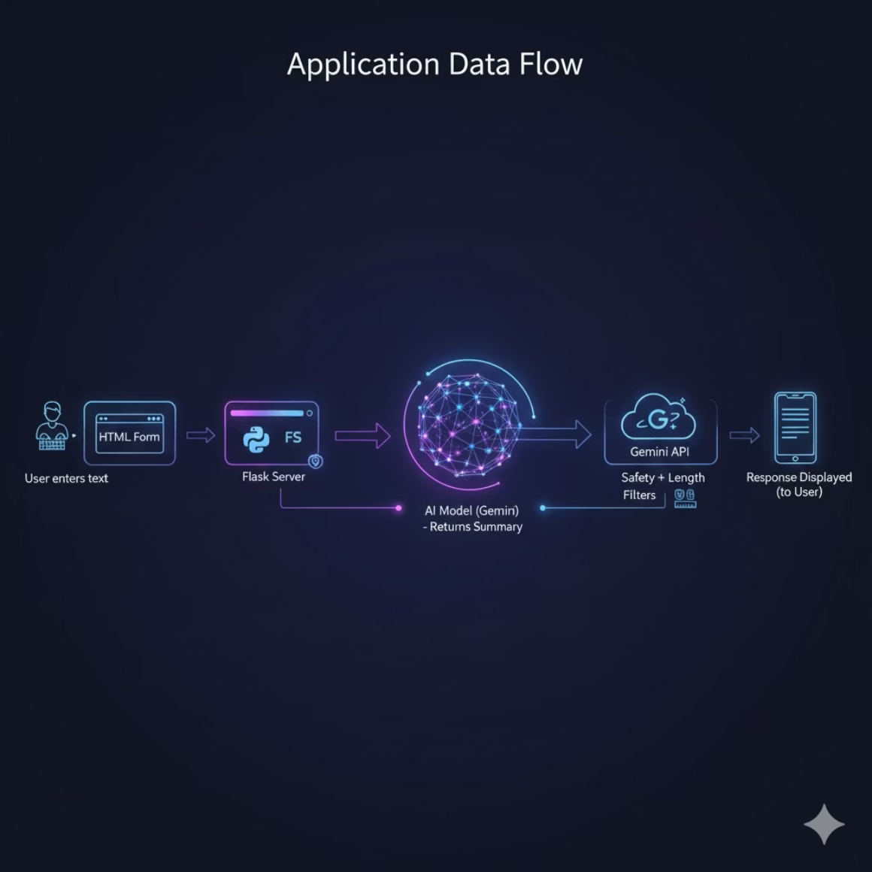
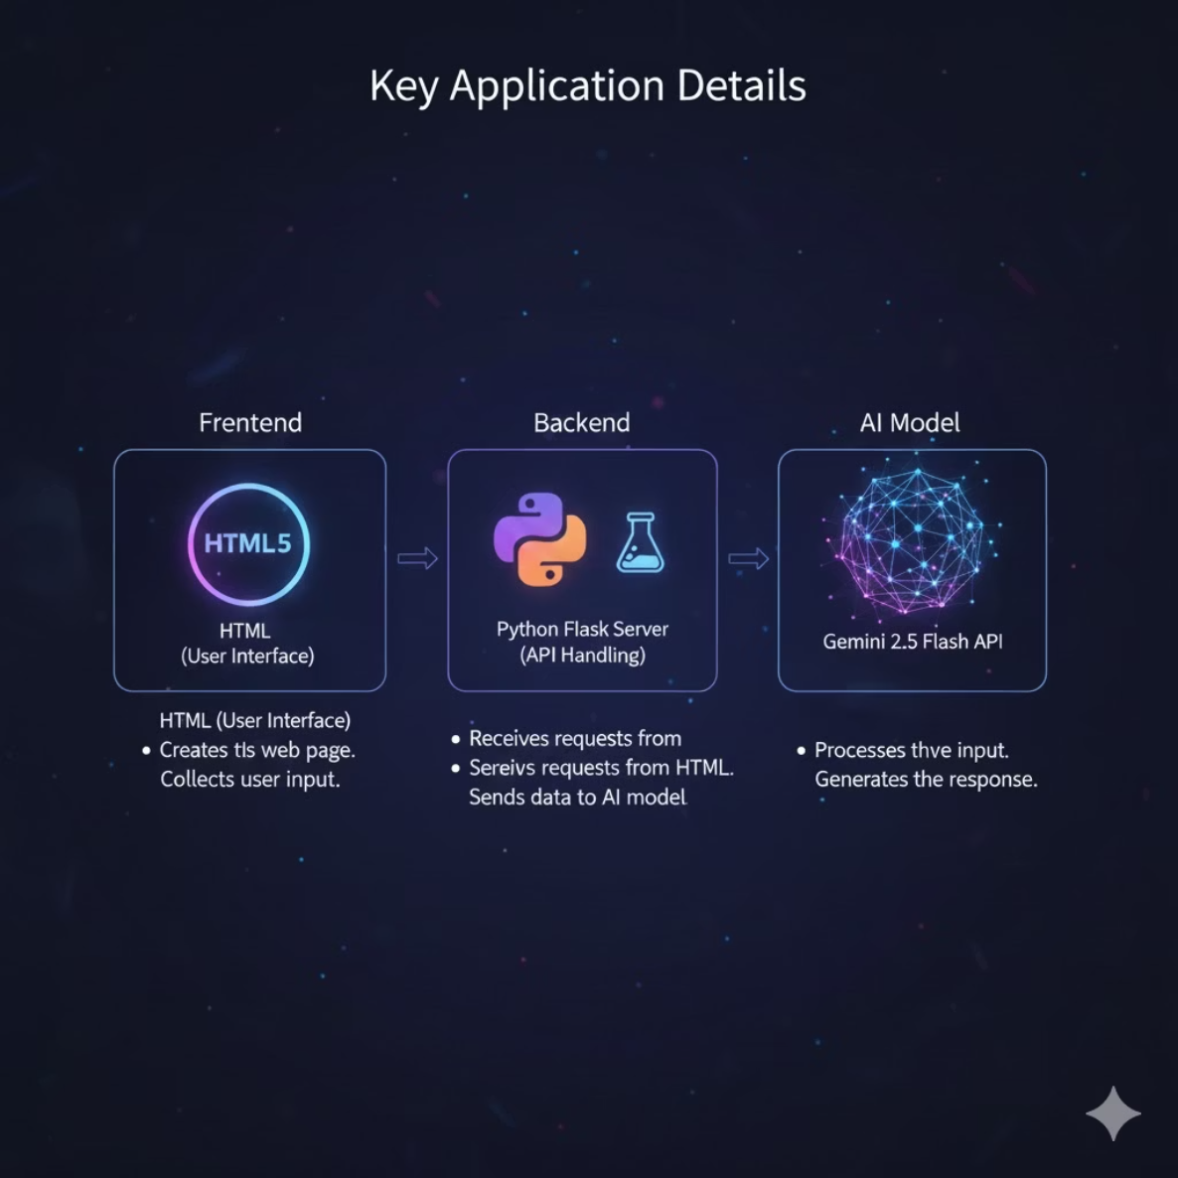
Project Overview: Responsible Text Summarizer
Key Details
Workflow
Frontend: HTML
User enters text → HTML form → Flask server → Gemini API → Model returns summary → Safety + length filters → Response displayed.
Backend: Python Flask
Model: Gemini 2.5 Flash API

Slide 9

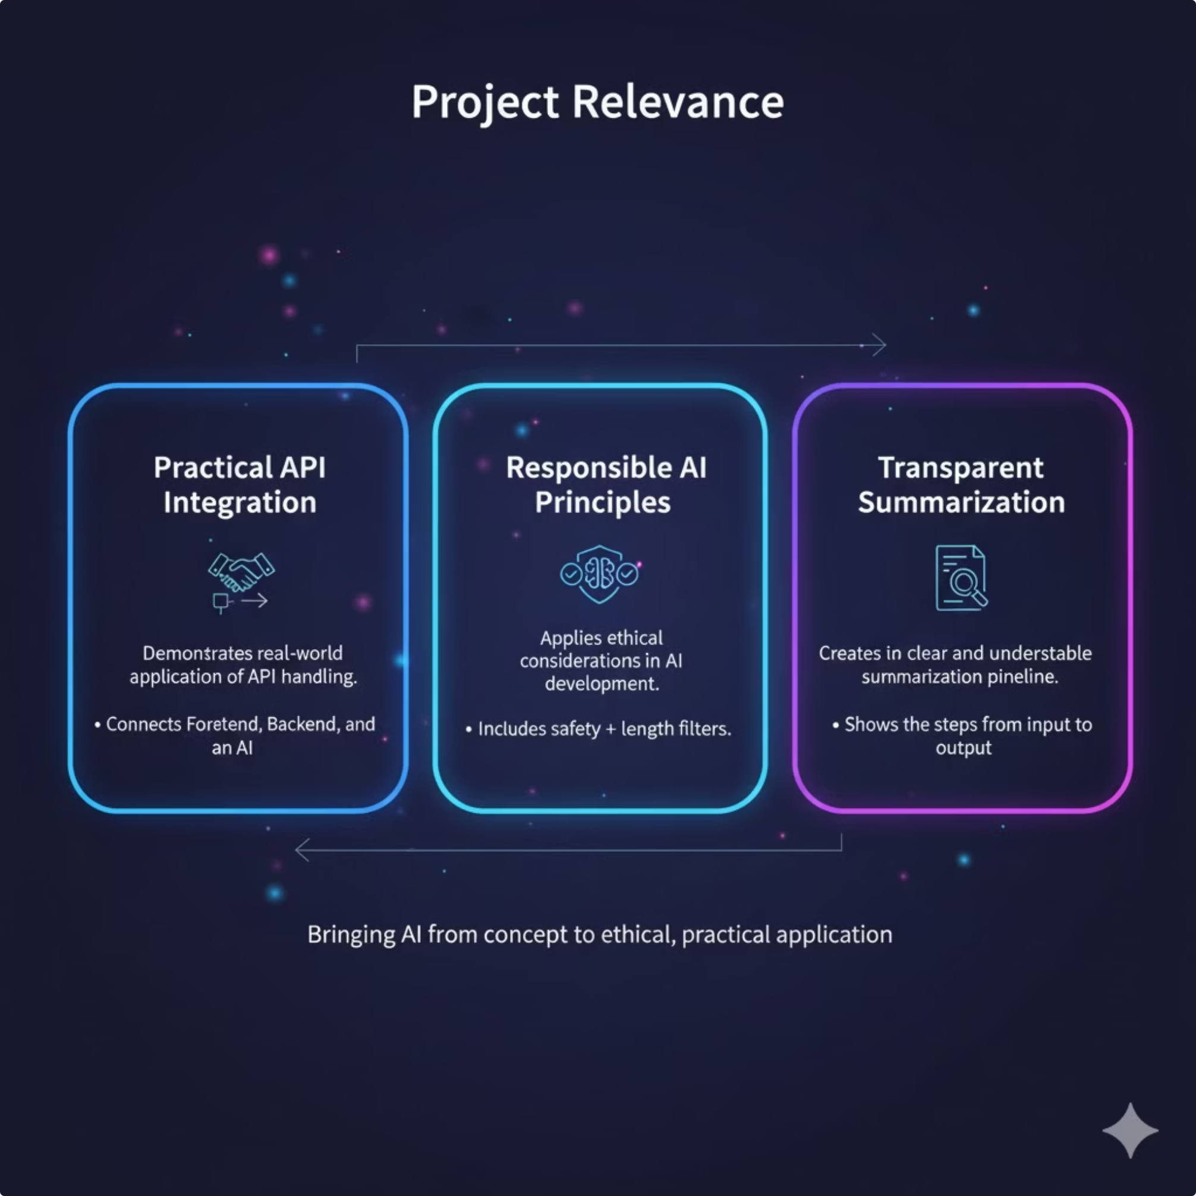
Project Relevance :
Practical API Integration: This project demonstrates a real-world application of handling external APIs to bridge the gap between user data and AI processing.
Responsible & Transparent AI: It applies ethical development principles to ensure clear, unbiased, and understandable automated summarization pipelines.

Slide 10

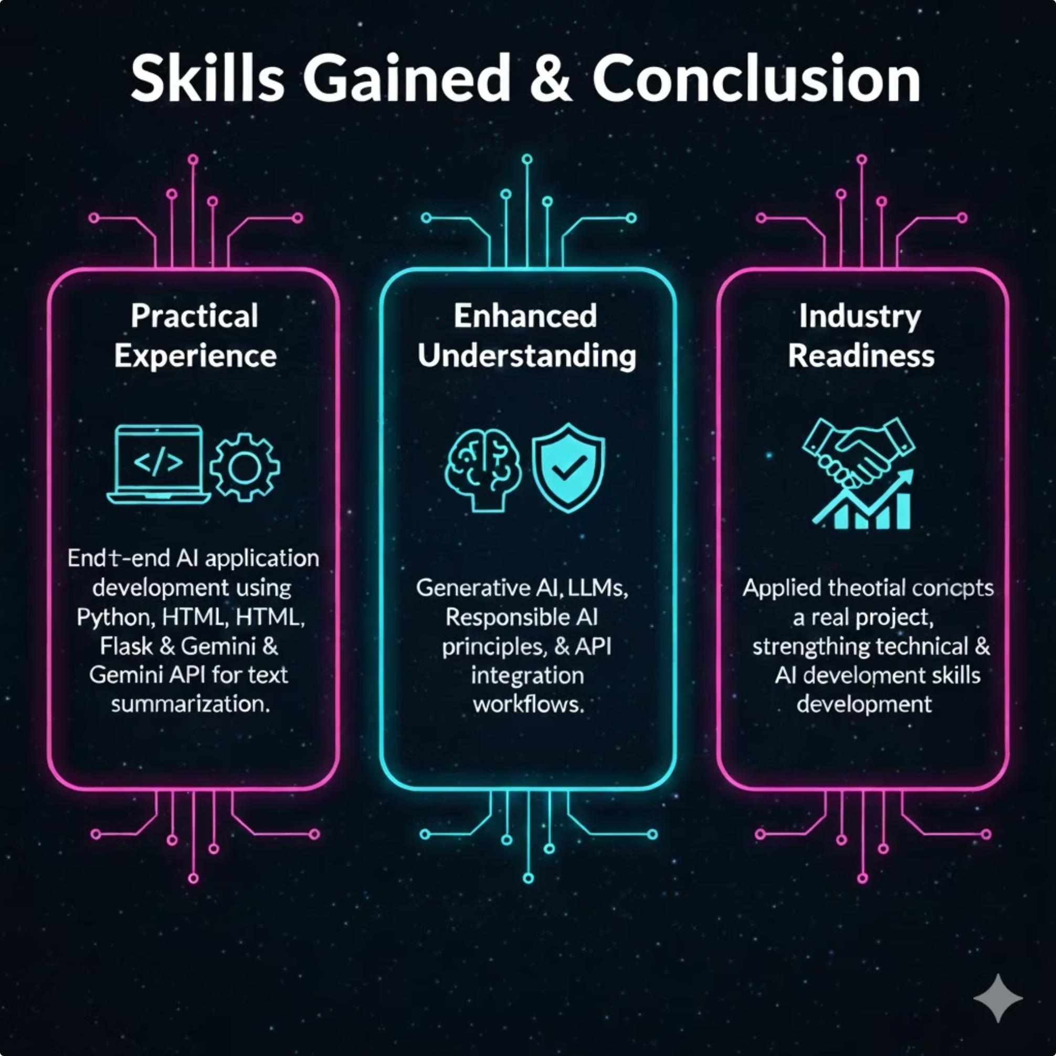
Skills Gained & Conclusion
I gained practical skills in generative AI, LLM working, Python-Flask development, and Gemini API integration through building an end-to-end summarization system. The course and project strengthened my technical understanding and prepared me for responsible, industry-aligned AI development.

